Slide 1

Why you must register!
June 8-12
Vancouver Four Season

Slide 2
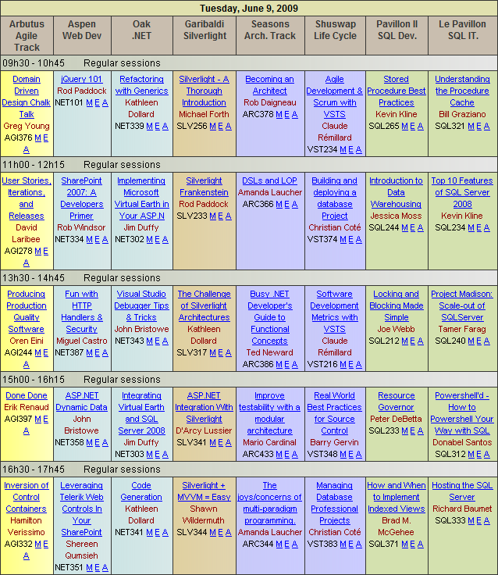
Why Not? - What does it look like?
Over 60 hours of training per day in 8 rooms. Check the schedule

Slide 3









Why Not? - What does it look like?
ALL day Pre-Conference
ALL day Post-Conference

Slide 4

Why Not? - What does it look like?
MVP’s, RD, MS Employees, Open Source Guy too!
International Speakers – They travel the globe

Slide 5

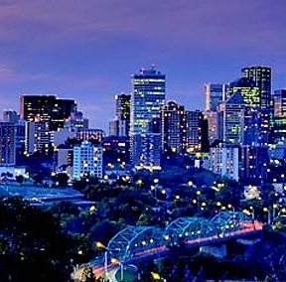
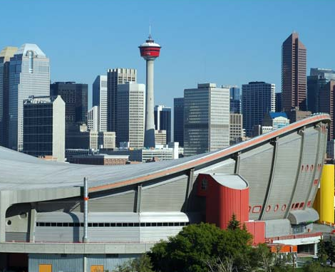


Why Not? - What does it look like?
Technology is moving forward - IT Jobs are hot in Vancouver, Edmonton and Calgary, but you need the skills

Slide 6
















Here is just one example of an International Speaker: Over 55 Speakers

Slide 7
Session Tracks – Something for Everyone
Web development (ASP.NET, AJAX,Cloud ,WCF)
Silverlight 2.0/3.0 track ( Toolkit, SDK, DMZ, MVVM)
Agile (TDD,Continuous Integration,Agile Design,Refactoring)
.NET 3.5 (WPF,WCF,WF,LINQ)
Architecture (Application design,Architecture P&P,SOA,...)
SQL Server 2008 IT (BI,SSIS, SSAS, SSRS,DBA)
SQL Server 2008 development (T-SQL,Dev with SQL)
Application Life-cycle Management track (VSTS)

Slide 8





Top 10 ways to convince your boss to go!
1- The speakers, mostly independent consultants, provide training on issues from real projects in the field.

Slide 9

Top 10 ways to convince your boss to go!
2- The industry is evolving so fast that it's hard to follow and the only way you can stay up-to-date is to attend a conference every 18 months.

Slide 10

Top 10 ways to convince your boss to go!
3- Attending a conference put me in contact with the best minds in the industry. It is the best way to network with writers, trainers, Regional Directors and MVP’s.

Slide 11
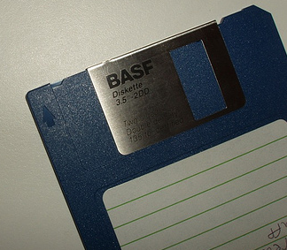
Top 10 ways to convince your boss to go!
4- By the time you find the time to read books, they are obsolete. Conferences save time by catching up on important areas of interest in the industry.

Slide 12

Top 10 ways to convince your boss to go!
5- Conferences typically cause you to think outside the box and see techniques, tricks, and technologies that normally wouldn't be covered in a training class.

Slide 13
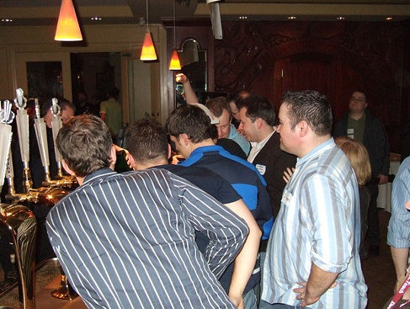
Top 10 ways to convince your boss to go!
6- Frequently the most interesting conversations happen late at night in the conference hotel bar. :)

Slide 14

Top 10 ways to convince your boss to go!
7- This conference is offering over 136 sessions in three days. It's providing the most content at a very low cost.

Slide 15
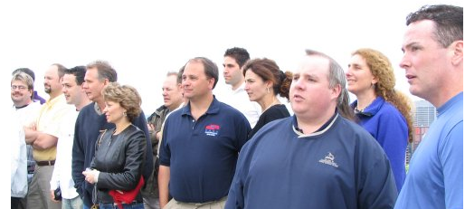
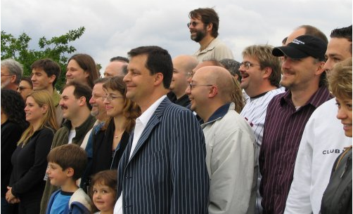

Top 10 ways to convince your boss to go!
8- DevTeach has the most MVP’s, RD’s and famous writers of all the independent conferences. This conference has over 55 speakers

Slide 16
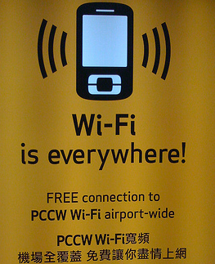
Top 10 ways to convince your boss to go!
9- DevTeach is providing free wireless internet access on site which helps you stay in touch with the office.

Slide 17

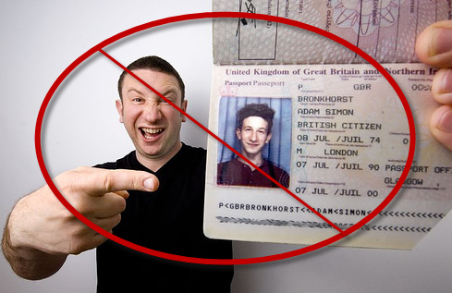

Top 10 ways to convince your boss to go!
If you are local this conference is a great deal. No Hotel, No Passport, No being away from family, No flights, No Dinner Expenses, and No Foreign Currency Exchange needed

Slide 18
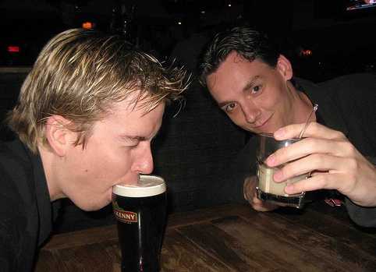
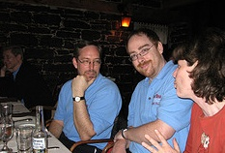
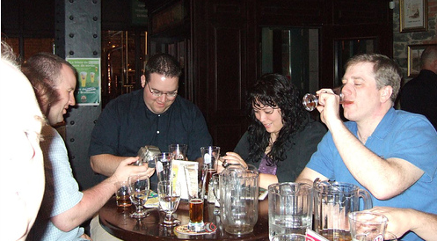
Things you do not need to tell your boss
Don’t tell them about the Party and it’s open Bar!

Slide 19
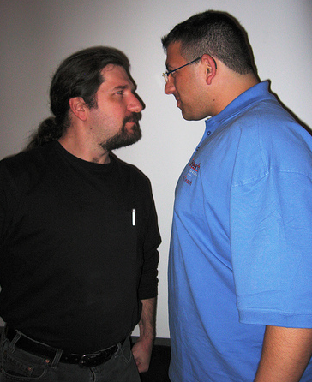

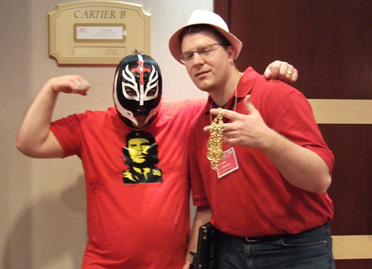
Things you do not need to tell your boss
Don’t tell them about the other free events like the Experts Panel Discussion (DNR) on Wednesday night

Slide 20

Things you do not need to tell your boss
The IT Market in Canada is HOT – they better send your or they could lose you!

Slide 21
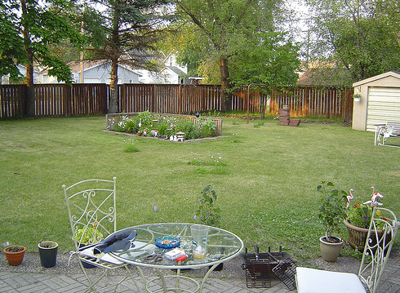
Things you do not need to tell your boss
It’s in YOUR back yard – YOU make or break it, but you also risk being left behind

Slide 22

Things you do not need to tell your boss
You need to convince your Boss to go to insure a bright future in this business

Slide 23
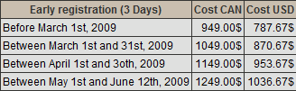

Don’t wait - you need to register early!
TechEd cost $2000 US
Buy 2 main conference pass and receive one free = to 35% off.
Use the UG rebate code of $100 off
www.devteach.com

Slide 24
What is DevTeach / SQLTeach again?
DevTeach and SQLTeach is not just a conference
It’s a festival! ☺

